Slide 1
Use Cases Diagram & System Sequence Diagram
Lecture 06
Course Instructor: Idrees Ahmad
Course Code: SE321

Slide 2
Use Case Diagrams
A use case diagram is used to represent a set of use cases, the actors and relationship between them.
It provides an overview of the System and its use cases.
It is a UML Diagram thus uses UML notations.

Slide 3
Use Case Diagram
Use cases as ovals.
Actors as stick Figures
Or blocks with « actor » .
The « ... » notation called “guillemets”, used for quotes in French, Italian, and Spanish.
Primary actors go on the left and others on the right.
Lines of communication between use cases and actors

Slide 4
System under discussion name

Slide 6
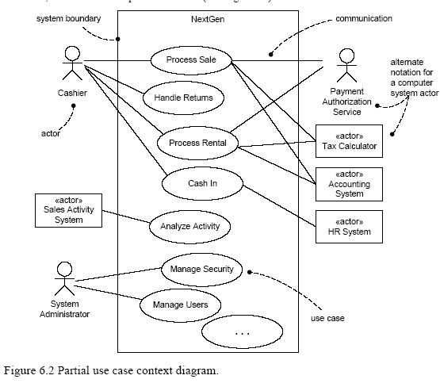

Slide 7
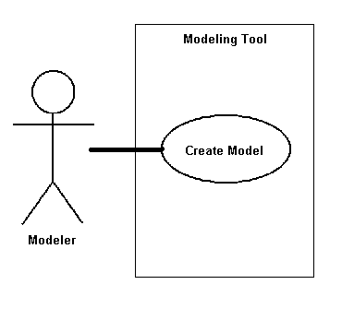
Association Relationship
An association is the communication path between an actor and the use case that it participates in
Shown as a solid line
No arrow head
Normally read from left to right

Slide 8
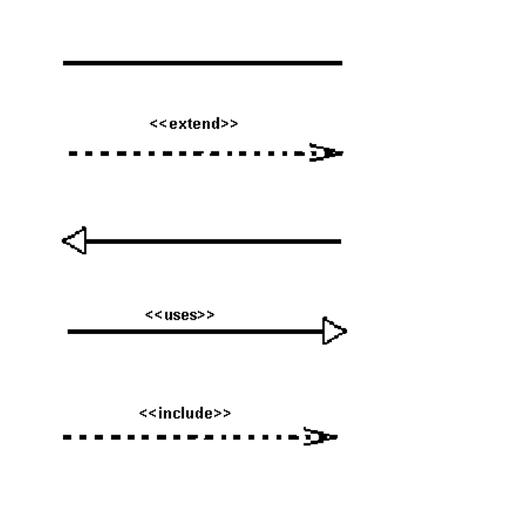
Use Cases Relationships
There are several Use Case relationships:
Include
Extend

Slide 9
The include Relationship
Some use cases include some behavior that is common across several use cases.
This is simply refactoring and linking text to avoid duplication
Example:
Description of Paying by Credit occurs in several use cases, including Process Sale, Process Rental, etc. Thus rather than duplicating text, it is desirable to separate it into its own sub-function use case, and indicate its inclusion.

Slide 10
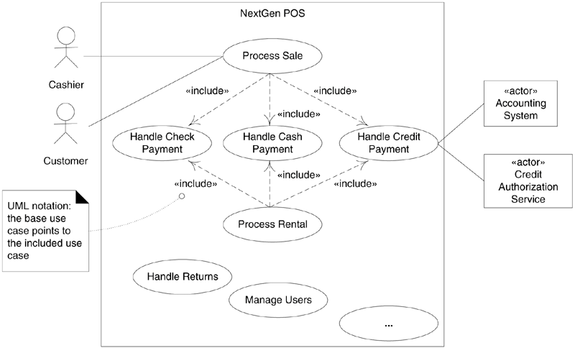
Notes:
User goal vs sub-function level page 73 level filed.
Avoid pre-post conditions that are obvious… do not add noice to requirements documents.

Slide 11
Concrete vs. Abstract Use Cases
Concrete use case is initiated by an actor and performs the entire behavior desired by the actor.
Process Sale is a concrete use case.
An Abstract use case is a sub-function use case that is part of another use case.
Handle Credit Payment is an abstract use case and is part of another Process Sale.

Slide 12
Base vs. Addition Use Cases
A use case that includes another use case, or that is extended or specialized by another use case is called a base use case.
Process Sale is a base use case with respect to the included Handle Credit Payment use case.
The use case that is an inclusion, extension, or specialization is called an addition use case.
Handle Credit Payment is the addition use case in the include relationship to Process Sale.
Addition use cases are usually abstract. Base Use cases are usually concrete.

Slide 13
The extend Relationship
The idea is to create an extending or addition use case, and within it, describe where and under what condition it extends the behavior of some base use case.
Suppose a use case's text should not be modified (at least not significantly) for some reason.
Helps in appending the use case without modifying its original text.
Notes:
myriad >> countless/many

Slide 14
Example:
UC1: Process Sale (the base use case)
…
Extension Points: VIP Customer, step 1. Payment, step 7.
Main Success Scenario:
1.Customer arrives at a POS checkout with goods and/or services to purchase
.…
7.Customer pays and System handles payment
.…
UC15: Handle Gift Certificate Payment (the extending use case)
…
Trigger: Customer wants to pay with gift certificate.
Extension Points: Payment in Process Sale.
Level: Subfunction
Main Success Scenario:
Customer gives gift certificate to Cashier. Cashier enters gift certificate ID. …
Notes:
This is an example of an extend relationship. Note the use of an extension point, and that the extending use case is triggered by some condition. Extension points are labels in the base use case which the extending use case references as the point of extension, so that the step numbering of the base use case can change without affecting the extending use caseindirection yet again.

Slide 15
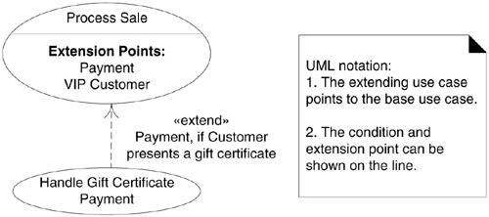

Slide 16
System Sequence Diagram

Slide 17
System Behavior
System Behavior describes what a system does, without explaining how it does it.
Before making a logical design of how the software system should work, we need to investigate and define its behavior as “Black box”.
System Sequence Diagrams (SSD)
SSD are part description of System behavior.
Notes:
Chap 10 3rd Ed;
People do Seq Diagrams (without SSD, but would be complex as tacking larger problem and would be a large step, rather moving slowly, stepwise).

Slide 18
System Sequence Diagrams
System sequence diagram (SSD) are used to illustrate interaction between actor and system for a particular scenario of a use case.
A system sequence diagram is a picture that shows, main success scenario, the events that actors generate their order, inter-system events.
The purpose is to illustrate the use case in a visual format.
SSD are drawn using UML notations
UML does not define “System Sequence Diagrams”, but includes Sequence Diagrams.
We draw SSD using Sequence Diagram notation

Slide 19
Use cases describe how actors interact with the software system and during this interaction
an actor generates system events to a system
usually requesting some system operation to handle the event
SSD show how certain tasks are done between users and the system.
The tasks could be simple, complex or repetitive tasks.

Slide 20
Creating System Sequence Diagrams
Should be done for the typical course of events/main success scenario of the use case (and for the most interesting alternative course).
Draw a line representing the system as a black box.
Identify each actor and draw a line for each such actor.
From the use case typical course of events text, identify the system (external) events that each actor generates.
Illustrate them on the diagram.
Optionally, includes the use case text to the left of the diagram.

Slide 21
Process Sale

Slide 22
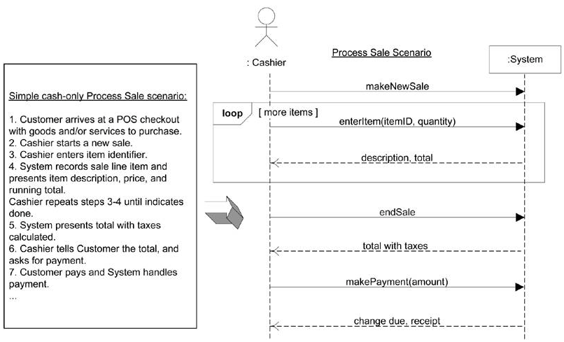

Slide 23
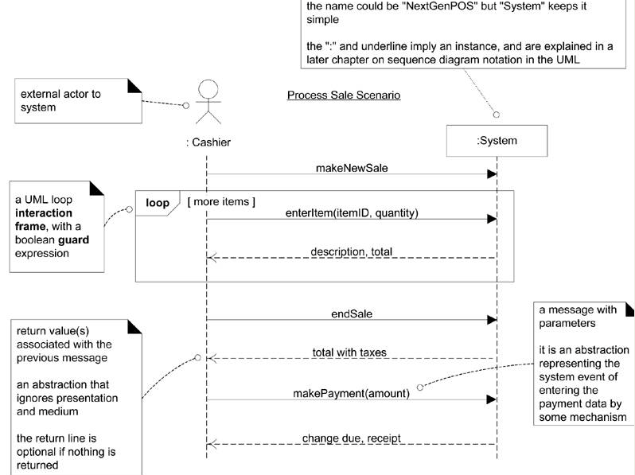

Slide 25
System Events
System event is an external input event generated by an actor (may include parameters).

Slide 26
Naming System events & operations
System events and associated system operations should be expressed at the level of intent
Use verbs from use case or make,start,enter,end etc.. rather than physical input medium or UI widget
Notes:
Vereb phrase similar to process name (of DFD).

Slide 27
Boundary of system can also be shown, it help in clarity of their actions and events generated
Cashier
:System
enterItem(UPC, quantity)
endSale()
makePayment(amount)
system boundary

Slide 28
System Operations
Operations that the system as a black box offers in its public interface to handle incoming system events.
System operations can be identified by discovering these system events

Slide 29
Cashier
System
makeNewSale()
These input system events invoke system operations
enterItem(itemID, quantity)
Description, total
The system event makeNewSale invoke a system operation called makeNewSale and so on
[More items]
endSale()
Total with taxes
makePayment(amount)
Similar to OOP when we say the message to invoke the method (handling operation)
Change due, receipt
System operations handle input system events.

Slide 30
Thank you!!!
Chapter 8-9 Applying UML Pattern and Design, Craig Larman,2nd Edition

